Slide 1
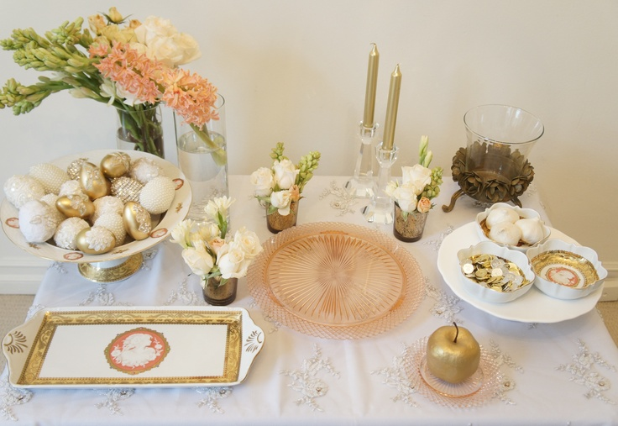
Nowruz
Celebrations
On the first day of Nowruz Families gather around a table to wait for the exact moment of the arrival of the spring when they exchange gifts
On the table or floor will be the Haft-Sin which consists of seven specific items beginning with the letter 'S'
Sumac (crushed spice of berries): For the sunrise and the spice of life
Senjed (sweet dry fruit of the lotus tree): For love and affection
Serkeh (vinegar): For patience and age
Seeb (apples): For health and beauty
Sir (garlic): For good health
Samanu (wheat pudding): For fertility and the sweetness of life
Sabzeh (sprouted wheat grass): For rebirth and renewal of nature

Slide 2
Nowruz
Celebrations
Other things that may be on the table include
coins (for wealth)
candles (enlightenment and happiness)
mirror (cleanness and honesty)
decorated eggs (fertility)
goldfish in a bowl (said to represent unexpected favors to be received in the coming year) and life
rosewater (believed to have magical cleansing powers)
poetry and/or a holy book

Slide 3
